Slide 1
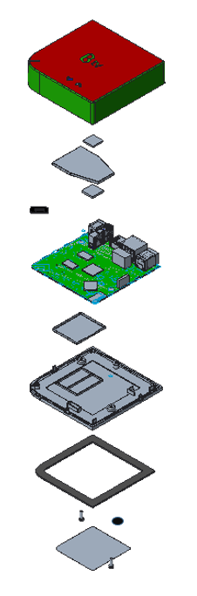
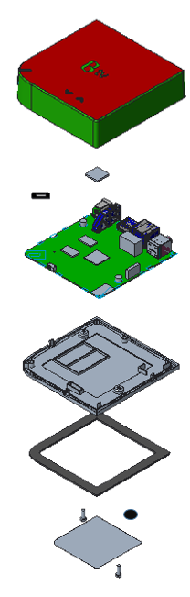
Housing explosive view
Original:
Remove shielding cover
Top cover assembly
Top cover assembly
Chip thermal pad outside
Chip thermal pad
Chip shielding cover
Sponge
Chip thermal pad inside
Sponge
Main board
Main board
Bottom cover
Shielding cover bottom
Bottom cover
Rubber foot
Warranty label
Rubber foot
Unit label
Screw *2
Warranty label
Unit label
Screw *2

